Slide 1

DEPARTMENT OF INFORMATION TECHNOLOGY
TripPlanner : A Dynamic Tourism Recommender System
Batch No – 5
Mohammed Zaid - 212219220031
Sureshram E - 212219220054
Akilla Venakata Sesha Sai- 212219220060
Dr. G. NaliniPriya, M.E.,Ph.D.
Professor

Slide 2
AGENDA
INTRODUCTION
OBJECTIVE
SCOPE
LITERATURE SURVEY (in Tabular column)
EXISTING SYSTEM & DRAW BACKS
PROBLEM DEFINITION
PROPOSED SYSTEM
SYSTEM ARCHITECTURE
MODULES (with Description and Flowchart/ UML/ Pseudo Code)
OUTPUTS (Screen shorts and Results/Graphs)
SWOT Analysis
CONCLUSION
FUTURE ENHANCEMENT
REFERENCES

Slide 3
ABSTRACT
Smartphones are now an integral part of the lives of the majority of people. There is an ever-increasing demand for mobile computing applications that focus on people's daily lives. In such applications, location-dependent systems have been identified as having significant applications. The application Smart City Guide presents the architecture and implementation of such a location. The primary objective of this project is to investigate how to implement a mobile city guide on the Android platform, including the development of a guide prototype. The project employs the design science research method. The project objective is attained by designing and implementing an artefact (a prototype of a city guide). In conclusion, the project is evaluated across four facets: platform evaluation, general functional evaluation, scenario evaluation, and non-functional evaluation. The implemented prototype includes fundamental city guide features such as displaying a map and locating points of interest (POIs). Moreover, the project must determine how to integrate current technologies, such as Google Maps and the phone application, into the prototype. The application reassures a new city resident by displaying information about all the nearby public access sites. There are hospitals, a police station, the city's main attraction, and renowned restaurants. In addition, non-functional aspects such as extendibility, tolerability, and usability have been investigated. On the new mobile Android platform, the project presents a comprehensive but unrealized city guide.

Slide 4
INTRODUCTION
A city guide is essential whenever we visit any new city.
But carrying a book or finding offline resources is a hassle.
The SmartCity app provides users with everything they might possibly need while on the road, reducing stress associated with travel.

Slide 5
OBJECTIVE
The primary objective of the project is to simplify the process of travelling to unfamiliar locations for people by providing them with access to all of the fundamental functionality, including maps, points of interest (POIs), and landmarks, without making it too difficult to locate these features.
When elements of this kind are integrated with existing technologies such as Google Maps, customers are provided with an android application that puts all of the services and amenities located in their immediate city at their fingertips.
The app helps a person who just moved to a city feel more at home by giving them information about all the public places nearby.

Slide 6
SCOPE OF THE PROJECT
It is accessible to an infinite number of users.
The user can access all of the site's information with restricted services, and registered users have access to more features.
Track the user's information. Verification of the end user's identification and authorization to obtain support.
Maintain a record of each customer's past transactions. Maintain a customer's history and associated information.

Slide 7
S.NO | TITLE | AUTHOR/YEAR | WORKDONE | RESULTS & LIMITATIONS
1 | Using context analysys for providing real time recommendations in e-tourism mobile location-based recommender systems | Olga Artemenko; Volodymyr Pasichnyk; Natalia Kunanec; Danylo Tabachyshyn/ 2019 | This paper describes main modern tendencies for the design and development of e-tourism recommender systems with real time support. This paper focuses on development of e- tourism mobile location-based recommender systems with context analysys function. Main goal is to enable better real time recommendations for trip support in time-location amplitude. | Contextual information can be provided to the mobile e- tourism recommender system in several ways the context is used as part of the recommendations constructing process, and contextual data is used when calculating the ratings of a particular alternative.

Slide 8
S.NO | TITLE | AUTHOR/YEAR | WORKDONE | METHODOLOGIES USED
2 | Personalized Travel Recommendation Based on Sentiment-Aware Multimodal Topic Model | Xi Shao; Guijin Tang; Bing-Kun Bao/ 2019 | In this paper, The personalized travel recommendation problem is being solved by exploiting the multi-modal data available from the real world social media, and a probabilistic graph model so called Sentiment-aware Multi-modal Topic Model (SMTM) is proposed to mine the latent semantics of the multi-modal data on the online travel website. Distinguished from previous approaches, the proposed approach try to mine the topics from tourist and attraction domains separately for disclosing semantics for tourist topics and attraction themes. In addition, tourist's sentiments are analyzed on attractions to further obtain the tourist's attitude over attractions and recommend the attraction with proper sentiment on the related attraction themes accordingly. | The documents in tourist domain and in attraction domain can be compared with each other after they were projected into the mutual topic space, and this latent space projection scheme can be further applied to two personalized traveling recommendations recommendation. Evaluation results based on the real world online travel website have shown the improved performance of our method

Slide 9
S.NO | TITLE | AUTHOR/YEAR | WORKDONE | METHODOLOGIES USED
3 | Approaching Another Tourism Recommender | Xianfeng Chen; Qing Liu; Xiangjie Qiao/ 2020 | This paper analyses the concept, application and development status of travel recommender systems through the collection and arrangement of relevant literature published in recent years. Also, it pays special attention to the analysis of key technologies in the system, pointing out its complexity and uniqueness an application. Besides, the limitations of recommendation methods based on collaborative filtering and content-based filtering are considered as well, then the using knowledge-based filtering or hybrid recommendation method is proposed. It also discusses the role and application of tourism decision-making theory in the recommender system, and finally puts forward a general model of travel recommender system and future research hot spots. It's wished that this research can expand the vision and serve as a reference in this field. | Collaborative filtering has the ability to introduce new items, make novel recommendations, and explore potential but unknown interests of users, which is suitable when recommending unstructured items that are difficult to analyze. Content-based recommendation constructs user profiles by analyzing the characteristics of those preferred items Knowledge-based filtering makes recommendations on the base of user and product information, which means generating a reasoning process to discover which product most fits the user's needs [

Slide 10
S.NO | TITLE | AUTHOR/YEAR | WORKDONE | METHODOLOGIES USED
4 | The Optimal Tour Problem in Smart Tourism Recommender Systems | Yurii Tulashvili; Yurii Turbal; Driwi Abd Alkaleg; Volodymyr Pasichnyk; Al Shukri Sumayya Ali; Nataliia Kunanets/ 2020 | In this paper it is investigated a structure of the SMART tourism recommender system. Basic approaches for generating recommendations in an automated mode for selecting the best tourist routes in the SMART City Tourism network has been determined. This approaches are based on the analysis of the accumulated information about the most popular tourist destinations. It is proposed a mathematical model which provides, on the basis of knowledge about tourist sites, the possibility of construction optimal sequence of tourist routes. The proposed algorithm are based on the technology of online analytical processing of OLAP data selected from DW and organized in the form of OLAP Cubes . | It explains the various problems in the smart tourism recommendation systems The problems in the system varies from using gps data for route selection to the mathematical model used for recommendations.

Slide 11
S.NO | TITLE | AUTHOR/YEAR | WORKDONE | METHODOLOGIES USED
5 | Toward a Smart Tourism Recommender System: Applied to Tangier City | Zineb Aarab, Asmae Elghazi, Rajaa Saidi & Moulay Driss Rahmani / 2018 | In this paper, It is explored how context information can be exploit to create intelligent and adaptive recommender systems. It provides an overview of the multiform notion of context with a discussion of several context oriented approaches and systems, and illustrates the usage of such approaches in several application areas. The vision of the notion of context through a context metamodel is presented along with an effective tourist recommendation system that respect personal preferences and capture usage, personal, social and environmental contextual parameters. | Context metamodel consists of organizing and presenting a more abstract view of context models in order to show their construction and manipulation. Metamodeling context is a major challenge for the identification of concepts involved in manipulating the context, their relationships, their formalization and presentation of their semantics

Slide 12
EXISTING SYSTEM
In Existing system, people who want to learn about a city need to talk to people who live there or hire a guide.
The user needs to gather of all these information in order to visit the city. This requires a lot of time and pre-planning. In order to get each piece of information the user also needs to know what to search each time.

Slide 13
PROBLEM DEFINITION
The development background is to create an operational platform that would manage the power consumption and operational resources in order to reduce the overall running operational cost.
To create something that can act as a tour guide and navigate and show the nearby places to tourists

Slide 14
LIMITATIONS OF EXISTING SYSTEM
The existing system is quite difficult to use for beginners. Here the city information exists individually and to search any place requires the user to manually search it each time..
There is also google maps which is very efficient but not easy to use when going to someplace new where the user doesn’t know what to look for.
In the existing system, multiple locations can’t be compared at a time, making it difficult for the user to select the best place nearby.

Slide 15
PROPOSED SYSTEM
The Proposed System provides information about the city in the form of an android application.
The system makes the travelling and searching for nearby locations much easier and and flexible.
It can be accessed over the Internet.
The city information files can be stored in centralized database which can be maintained by the system.

Slide 16
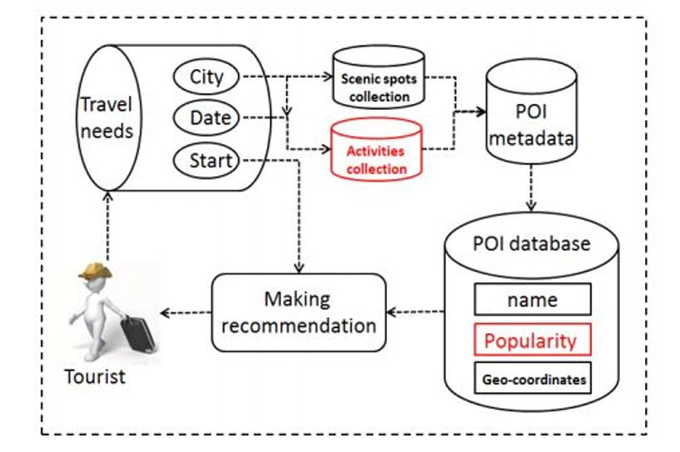
SYSTEM ARCHITECTURE

Slide 17
MODULES
User Registration and Authentication
Find destination location
Tourism And City Guide
Main information about cities

Slide 18
USER MODULE
User module is maintaining the information regarding the city tourist spot, hotels in the city entertainment in this city etc.., the user after registration as a tourist is considered as authorized user. The various software components in the tourist module are view theaters, view hotels, view city map, view ATM locations, view hospitals, view city history, view travel agency, view bus routes.

Slide 19
TOURISM AND CITY GUIDE
It is a section of the application which provides the detailed information about the area, the famous places of those areas, restaurants, hotels, shopping malls etc. and all the related details of these places. This provides the user an easy way to visit any place. It also helps the user to compare any two places before being able to visit it. This makes planning easy.

Slide 20
POI CATEGORIES
The application contains a lot of information about the various categories of nearby facilities and other amenities that a user might need. This is updated based on the geographic location through the use of GPS on the smartphone. So, when a user is in any particular location, they will be shown all the best possible landmarks, gyms, points of interest, famous hotspots etc. This is done live and gets shown in real-time to the user.

Slide 21
User Registration and Authentication
The app will ask the user to create an account.
The login credentials will be stored in firebase and be used to authenticate the user.

Slide 22
FIND DESTINATION LOCATION
The application has an inbuilt navigation system that will provide the shortest route between the current location and the destination.
So a user need not use any other app to for navigation purposes.

Slide 23
TOURISM AND CITY GUIDE
Provides info regarding the various aspects of city such as popular landmarks, institutes, industries, ATM locations, restaurants, shopping malls etc.
The implementation of this project solves most of the problems a new visitor faces while coming to a new city.

Slide 24
INFORMATION ABOUT CITIES
This will definitely help the users for the purpose of saving their valuable time which can’t be got back which is also economically viable. This system provides a registration form for all who wants to get the services. This can be categorized based on the type of users. They can search for a prominent places in the city without taking any help from personal guide.

Slide 25
PSEUDOCODE IMPLEMENTATION
// Step 1: Collect data
data = gather_data()
// Step 2: Preprocess data
data = preprocess_data(data)
// Step 3: Define similarity metrics
similarity_metric = define_similarity_metric()
// Step 4: Split the data
training_data, testing_data = split_data(data)
// Step 5: Build a model
model = build_model(training_data, similarity_metric)

Slide 26
PSEUDOCODE IMPLEMENTATION
// Step 6: Evaluate the model
performance_metrics = evaluate_model(model, testing_data)
// Step 7: Tune the parameters
tuned_model = tune_parameters(model)
// Step 8: Deploy the system
deploy_android_app(tuned_model)
// Step 9: Monitor and update
while (true) {
performance_metrics = monitor_system()
if (performance_metrics.degrade) {
update_system()
}
}
// Step 10: Test and refine
while (true) {
user_feedback = get_user_feedback()
if (user_feedback) {
refine_system(user_feedback)
}
}

Slide 27
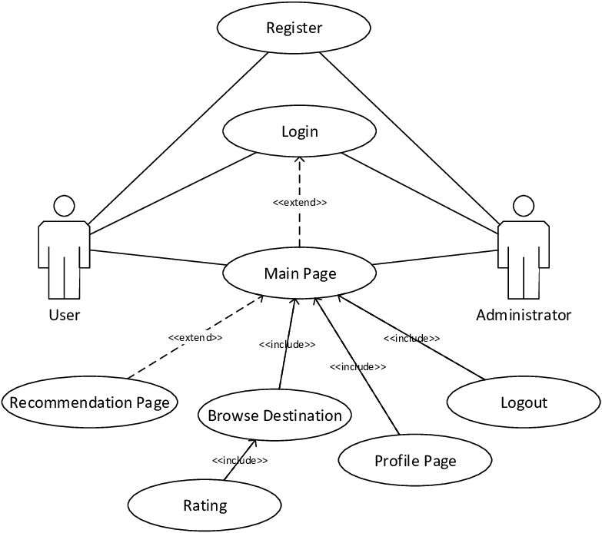
USECASE DIAGRAM

Slide 28
CLASS DIAGRAM

Slide 29
Sequence Diagram of the User

Slide 30
Admin Site Update Sequence Diagram

Slide 31
CONCLUSION
This Project in Java provides info regarding the various aspects of city such as tourism, institutes, industry, geographical maps, ATM locations, etc. The implementation of this project solves most of the problems a new visitor faces while coming to a new city such as: path finding, hotel searching, ticket booking, and more.

Slide 32
FUTURE ENHANCEMENT
As interesting directions of future work we identify the following two lines. First covering access range can be increased
Rating system can also be embedded according to the user satisfaction. Apart from android it can also be made for Windows and IOS users. Navigation system can also be integrate for a particular place.

Slide 33
REFERENCES
[1] O. Artemenko, V. Pasichnyk, N. Kunanec and D. Tabachyshyn, "Using context analysys for providing real time recommendations in e-tourism mobile location-based recommender systems," 2019 IEEE 14th International Conference on Computer Sciences and Information Technologies (CSIT), 2019, pp. 166-169, doi: 10.1109/STC-CSIT.2019.8929822
[2] X. Shao, G. Tang and B. -K. Bao, "Personalized Travel Recommendation Based on Sentiment-Aware Multimodal Topic Model," in IEEE Access, vol. 7, pp. 113043-113052, 2019, doi: 10.1109/ACCESS.2019.2935155.
[3] Chen, Liu, Q., & Qiao, X. (2020). Approaching Another Tourism Recommender. 2020 IEEE 20th International Conference on Software Quality, Reliability and Security Companion (QRS-C). https://doi.org/10.1109/qrs-c51114.2020.00097
[4] Y. Tulashvili, Y. Turbal, D. A. Alkaleg, V. Pasichnyk, A. S. Sumayya Ali and N. Kunanets, "The Optimal Tour Problem in Smart Tourism Recommender Systems," 2020 IEEE 15th International Conference on Computer Sciences and Information Technologies (CSIT), 2020, pp. 246-250, doi: 10.1109/CSIT49958.2020.9322043.

Slide 34
REFERENCES
[5] Aarab, Z., Elghazi, A., Saidi, R., Rahmani, M.D. (2018). Toward a Smart Tourism Recommender System: Applied to Tangier City. In: Ben Ahmed, M., Boudhir, A. (eds) Innovations in Smart Cities and Applications. SCAMS 2017. Lecture Notes in Networks and Systems, vol 37. Springer, Cham. https://doi.org/10.1007/978-3-319-74500-8_59
[6] Bornträger, C., Cheverst, K., Davies, N., Dix, A., Friday, A., & Seitz, J. (2003). Experiments with Multi-modal Interfaces in a Context-Aware City Guide. Human-Computer Interaction with Mobile Devices and Services, 116–130. doi:10.1007/978-3-540-45233-1_10
[7] Sowmya, M.R., Prakash, S., Singh, S.K., Maloo, S., Yadav, S. (2019). Smart Tourist Guide (Touristo). In: Shetty, N., Patnaik, L., Nagaraj, H., Hamsavath, P., Nalini, N. (eds) Emerging Research in Computing, Information, Communication and Applications. Advances in Intelligent Systems and Computing, vol 906. Springer, Singapore. https://doi.org/10.1007/978-981-13-6001-5_23
[8] Parameswaran, A.N., Shivaprakasha, K.S., Bhandarkar, R. (2021). Smart Tourism Development in a Smart City: Mangaluru. In: Reddy, A., Marla, D., Favorskaya, M.N., Satapathy, S.C. (eds) Intelligent Manufacturing and Energy Sustainability. Smart Innovation, Systems and Technologies, vol 213. Springer, Singapore. https://doi.org/10.1007/978-981-33-4443-3_31

Slide 35
REFERENCES
[9] Yan, X., Juan, Z. (2021). Research and Implementation of Intelligent Tourism Guide System Based on Cloud Computing Platform. In: MacIntyre, J., Zhao, J., Ma, X. (eds) The 2020 International Conference on Machine Learning and Big Data Analytics for IoT Security and Privacy. SPIOT 2020. Advances in Intelligent Systems and Computing, vol 1283. Springer, Cham. https://doi.org/10.1007/978-3-030-62746-1_27
[10] Santos, F., Almeida, A., Martins, C., Oliveira, P., Gonçalves, R. (2017). Tourism Recommendation System based in User Functionality and Points-of-Interest Accessibility levels. In: Mejia, J., Muñoz, M., Rocha, Á., San Feliu, T., Peña, A. (eds) Trends and Applications in Software Engineering. CIMPS 2016. Advances in Intelligent Systems and Computing, vol 537. Springer, Cham. https://doi.org/10.1007.
[11] P. Yochum, L. Chang, T. Gu and M. Zhu, "Linked Open Data in Location-Based Recommendation System on Tourism Domain: A Survey," in IEEE Access, vol. 8, pp. 16409-16439, 2020, doi: 10.1109/ACCESS.2020.2967120.
[12] K. A. Fararni, F. Nafis, B. Aghoutane, A. Yahyaouy, J. Riffi and A. Sabri, "Hybrid recommender system for tourism based on big data and AI: A conceptual framework," in Big Data Mining and Analytics, vol. 4, no. 1, pp. 47-55, March 2021, doi: 10.26599/BDMA.2020.9020015.

